Slide 1

PSPD
Alexio Peiris
W1761873 - 2018110

Slide 2
Introduction
Stuttering
Identification of stuttering
Correction of stuttering
Explanation of the proposed system
Novelty of the research
Explanation of the implementation

Slide 3
Stuttering
Stuttering is a speech disorder that affects the fluency of speech.
It is characterized by interruptions in the flow of speech, including repetitions, prolongations, and blocks.
Can also involve physical behaviours such as tension or movements of the face or body.
Can occur in both children and adults
Can have a significant impact on social, educational, and professional activities.
Stuttering can be caused by a combination of genetic, neurological, and environmental factors but the causes are not fully understood.
Speech therapy, self-help techniques, and the use of assistive technology are the existing treatments at the moment.

Slide 4
Identification of stuttering
Has been attempted multiple times and in multiple ways
Mainly aims to identify the core stuttering behaviours
TDNN’s identified to be suitable for capturing contextual aspects of the dysfluent utterances(Sheikh, 2021)

Slide 5
Correction of stuttering
No established ways to correct stuttering
Alternative, easy and fast solution
Established system which come closer to stuttering correcction:
- Descript

Slide 6
Novelty of the research
Problem novelty – Identify correctly the stuttering core behaviours by increasing achieved accuracies
Solution novelty – Correcting the stuttering instances in an audio file as at the moment there are no established solutions

Slide 7
Proposed system
The prosed system would have 4 major stages:
Input audio file
Identify stuttering in audio file
Correct stuttering in audio file
Output stuttering in audio file

Slide 8
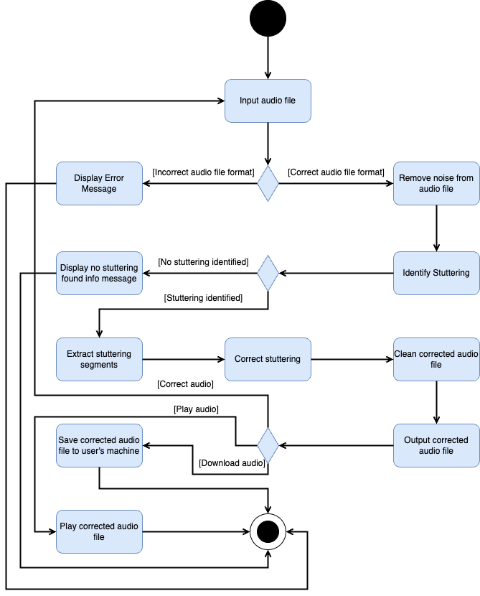

Slide 9
Implementation
Explanation of the implementation done upto now
https://github.com/AlexPeiris7/Dysfluency-detection-and-correction

Slide 10
Conclusion
System will be a contribution in the stuttering domain.
System will aim to have the highest accuracies possible when detecting the core stuttering behaviours.

